Slide 1


7143CEM Lecture 1: Week 1 Overview
School of Computing, Electronics and Mathematics Coventry University
7143CEM Programming for Data Science 2021/22 Semester 2

Slide 2
Learning programming
Many books promise to teach you programming in 24 hours or 7 days or 21 days or …
Peter Norvig, Director of Research at Google suggests it takes 10 years or 10000 hours https://norvig.com/21-days.html
TIOBE Index https://www.tiobe.com/tiobe-index/ Top 5 (Sept 2020): C, Java, Python, C++, C#

Slide 3
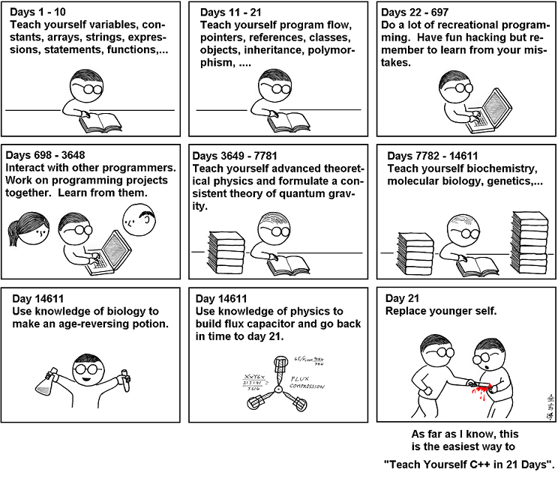
Learning programming
Notes:
https://abstrusegoose.com/249

Slide 4
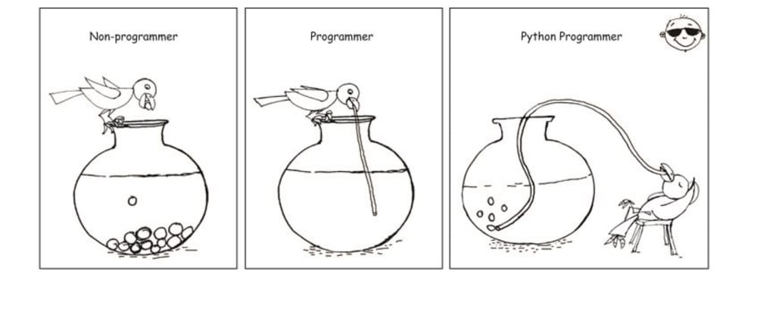
Skills of a good programmer
Problem solving
Inquisitiveness
Attention to detail
Logical thinking
Patience
Testing
Notes:
Image from: https://dev.to/javinpaul/10-python-articles-you-can-read-this-weekend-2df8

Slide 5
Intended Learning Outcomes
Demonstrate critical knowledge and systematic understanding of essential concepts of data science and computer programming.
Design, build, test, adapt and critique small programs in a high-level programming language.
Critically assess, select and apply data science tools, libraries or algorithms appropriate for various phases of the data science project lifecycle.

Slide 6
Why Python?
Free programming language (www.python.org)
Guido van Rossum (creator of Python) BDFL
Easy to learn, easy to read, easy to maintain
Top 10 programming languages (TIOBE index)
Very useful libraries for Data Science (Pandas, etc)
Zen of Python
print('Hello world')

Slide 7
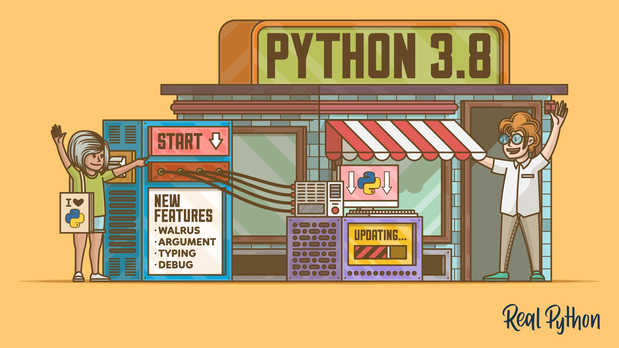

Python 2 vs Python 3
Beware there are two major versions of Python.
We will use Python 3 (current version is 3.8)
Python 2 reached its “end of life” on 1 January 2020 (just be aware of its existence)
Notes:
https://www.digitalocean.com/community/tutorials/python-2-vs-python-3-practical-considerations-2
https://realpython.com/python38-new-features/

Slide 8
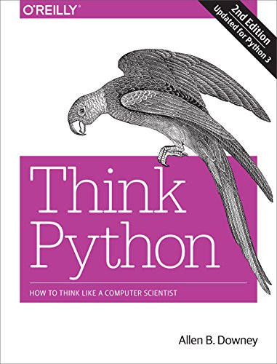
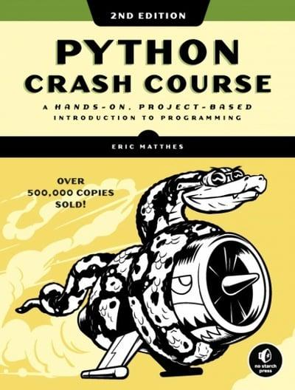
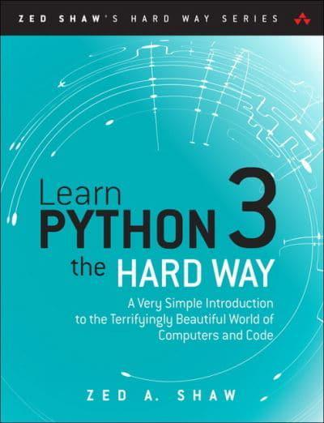
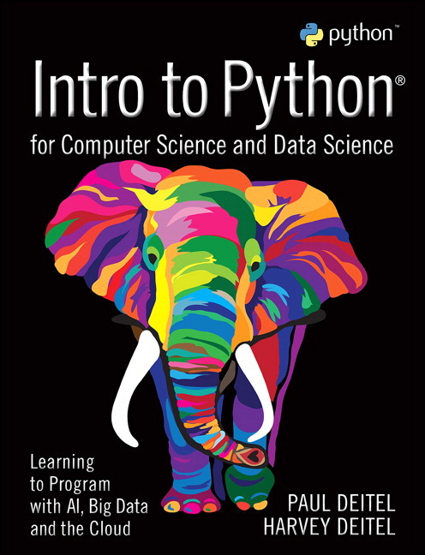
Recommended reading
Downey, Think Python (2ed), 2015 [free]
https://greenteapress.com/wp/think-python-2e/
https://github.com/AllenDowney/ThinkPython2/tree/master/code
Notes:
Skiena: https://www3.cs.stonybrook.edu/~skiena/

Slide 9
Week 1 – Install Python
Suggest you install Anaconda Individual Edition as it comes with many of the Python libraries we will use https://www.anaconda.com/products/individual
If you get stuck … ask for help or check … https://docs.anaconda.com/anaconda/install/
Try the Spyder IDE (comes with Anaconda)
Note that IDLE comes with all Python distributions

Slide 10
Week 1 – Monday
Study Think Python (2ed) – Chapters 1, 2 and 3
Values and types
Expressions, precedence (BODMAS), quotient and remainder
Variables and assignment (=)
Syntax errors
(continued …)

Slide 11
Week 1 – Monday (cont)
(continued)
Readable code (comments, descriptive variables names)
Built-in functions
Defining our own functions
Live session: live coding, problem solving, practice, questions

Slide 12
Week 1 – Tuesday
Study Think Python (2ed) – Chapters 5, 6 and 8
Strings and text
Making choices: Boolean type and if-else statements
Modules and methods
Random numbers
Live session: live coding, problem solving, practice, questions

Slide 13
Week 1 – Wednesday
Study Think Python (2ed) – Chapters 7, 9 and 10
Lists
Iteration (for and while loops)
Live session: live coding, problem solving, practice, questions

Slide 14
Week 1 – Thursday
Study Think Python (2ed) – Chapters 11, 12, 13 and Appendix A
Data structures: set, tuple, dictionary, stack
Debugging and testing
Live session: live coding, problem solving, practice, questions

Slide 15
Week 1 – Fun Friday
Algorithms – design/build/test
Searching and sorting
Recap
More examples
Further support

